Slide 1



HEALTHY HABITS
subtitle

Slide 2
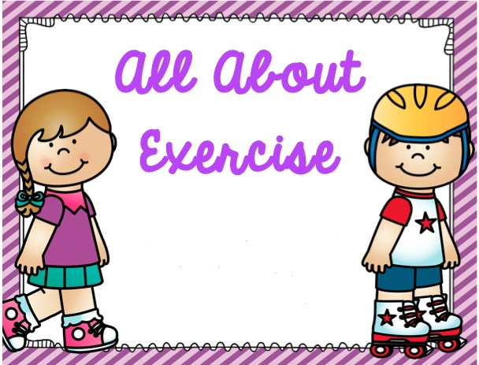

Slide 3
Exercise
Exercising is a great way to maintain a healthy life
At least an hour of exercise or physical activity
A regular exercise for children makes them feel less stressed
Promotes more energy, good memory and an optimistic feeling among themselves.
Help have an ideal weight, build healthy bones, muscles and joints.
Burn calories
Sleep better at night
Recommends 60 minutes or more of physical activity each day
Notes:
Exercise helps children do better at school, experts have said.
Allowing kids time away from the classroom to run around boosts their brain power, according to the team of international researchers.
A consensus statement signed by 24 researchers from eight countries, including the UK, says exercise is vital to children’s physical and mental health and improves academic results.
Published online in the British Journal of Sports Medicine, the statement says “time taken away from academic lessons in favour of physical activity has been shown to not come at the cost of scholastic performance”.
It adds that “physical activity and cardiorespiratory fitness are beneficial to brain structure, brain function and cognition” and “physical activity before, during and after school promotes scholastic performance in children and youth”.
Just a single session of moderate exercise has been shown to have an “acute benefit” on brain function, cognition and academic performance in children, while there are also many benefits in terms of mental health, the statement added.
Self-esteem as well as relationships with other children, parents and teachers are enhanced by the benefits of exercise, which also promotes social inclusion.
Furthermore, sports and physical activity programmes that follow a plan or a curriculum help children develop life skills such as being able to moderate one’s own behaviour, as well as teaching values such as respect, the statement said.
The statement was agreed by experts including from the UK, Scandinavia, and North America.
It looked at both structured physical activity and more unstructured forms - such as free play - on the health of children aged six to 18.
One section points to the physical benefits of exercise for children, such as reducing the risk of heart disease and diabetes in adulthood, adding that “physical activity is important in the treatment of many chronic diseases in children and youth”.
Effects
Lack of exercise for children can have many negative effects. In addition to being more likely to be overweight, children who don't get enough exercise have weaker muscles and bones than kids who exercise regularly. Inactive kids also have increased risk of developing type 2 diabetes, may have higher blood pressure and blood cholesterol levels and tend to have a more dismal outlook on life, according to
Recommends
do 60 minutes or more of physical activity each day. Parents should encourage their child to work on strength, endurance and flexibility. Children can build endurance through aerobic activities such as basketball, bicycling, skating and soccer. They can build strength with traditional toning exercises, such as pushups or pullups, and through play activities, such as climbing or gymnastics

Slide 4




Slide 5
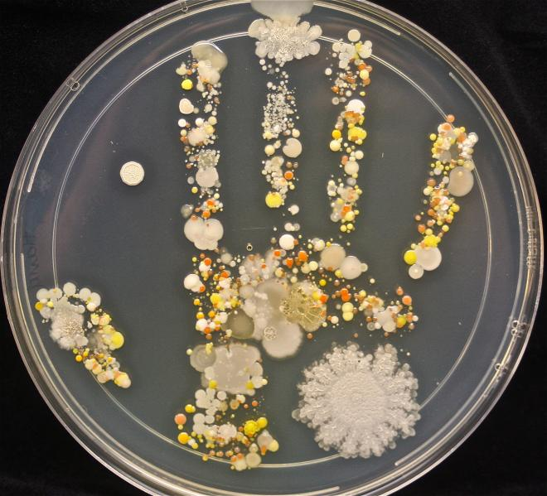
DISEASES THAT WE CAN GET WITH DIRTY HANDS
Common colds
Flu
Other infectious diseases

Slide 6
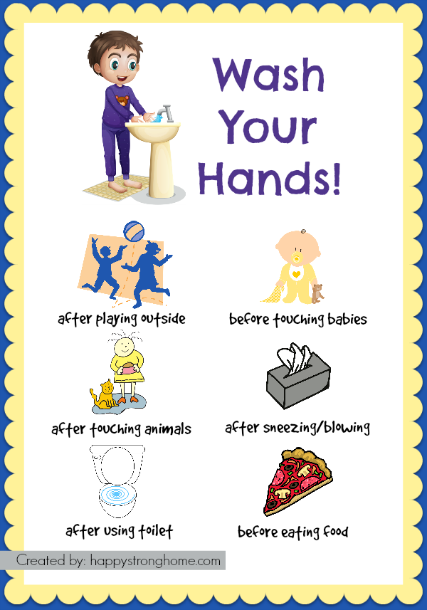
Notes:
Prevents and minimizes the spread of diseases

Slide 7
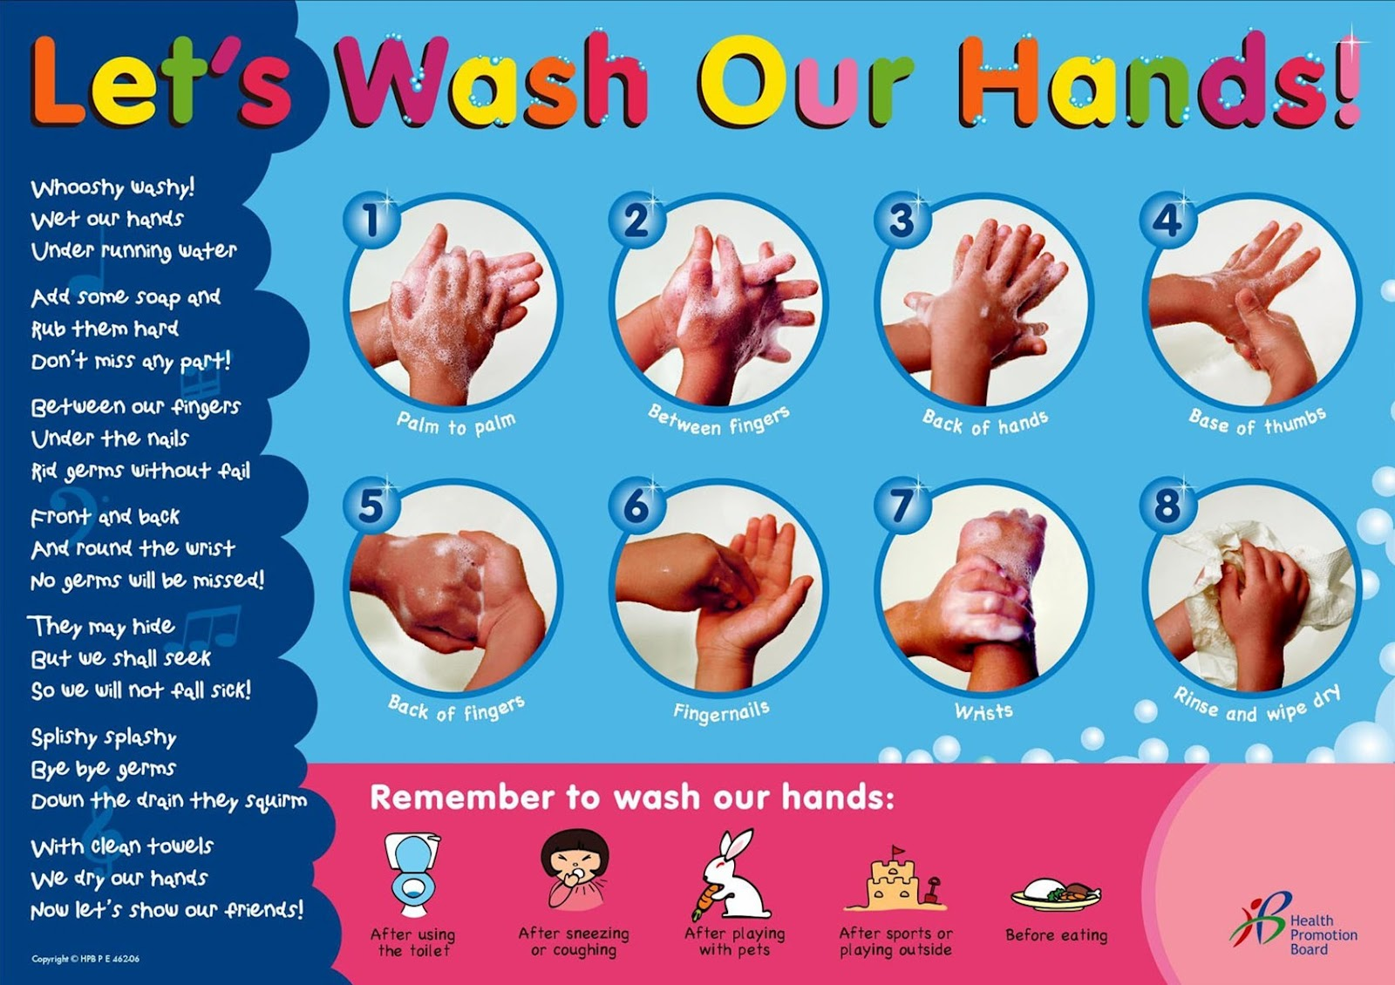

Slide 8

Bathing
The skin is the largest organ of the body and it acts as a protective layer against bacteria and other harmful germs.
Taking a bath regularly:
Provides physical and psychological benefits
Controls spread of infection and bacteria
Look good, feel fresh and avoid body odour
Notes:
Washing hair
Most young children can get away with washing their hair two or three times per week. Washing hair too often can dry out young scalps, making them more prone to dandruff.
As kids enter their tweens and teens, the hormonal effects of puberty take hold, sometimes making their hair greasy. Washing their hair with shampoo may be necessary at least every other day.
Bathing
Young children either love the bath or hate it. On non-shampoo days, you can make a thorough bath into a fun game. Have your child put on their bathing suit and place them into the tub with a washcloth, a bowl of warm, soapy water, and a bowl of warm water for rinsing. Make sure they know to put the washcloth into the soapy water before scrubbing a body part and then into the rinse water before repeating.
Skin care
Toddlers and preschoolers still need parents to help them with skin care. Skin blemishes such as the following are common at this age:
rashes
bumps
scabs
Before your child gets dressed after their bath, help them look over their skin from head to toe to make sure they don’t have any new blemishes that need care.
Oral hygiene
Clean teeth and gums can prevent a wide range of health issues, including bad breath, cavities, and heart disease later in life. Your child should brush and floss at least twice per day, if not after every meal. Older children can carry toothbrush kits in their backpacks so that they can brush at school. Younger children can help you time the full 2 minutes that a good brushing requires.
Nails
Fingernails are a breeding ground for bacteria. The germs that live under your child’s nails can easily transfer to their eyes, nose, and mouth. Invest in a good nail brush and help your child scrub the dirt out from under their nails before bedtime. A weekly clipping will help get rid of dirt and reduce the possibility of painful ingrown nails.
Toileting
Once young children become toilet trained, you’ll need to focus on the habits that keep little parts clean. Teach them to wipe thoroughly from front to back and wash their hands when they’re done. These healthy habits will help minimize irritation and keep infections at bay.
http://www.healthline.com/health-slideshow/hygiene-habits-kids#promoSlide

Slide 9
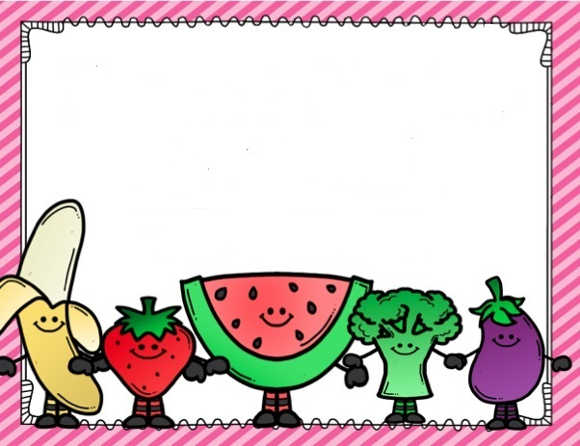
Proper Diet
Notes:
Poor nutrition can cause health problems, overweight, and obesity. Some of the health problems associated with poor nutrition can be very serious, especially as your child grows into an adult. By teaching your child healthy eating habits, you can help prevent these health problems.
Benefits of healthy eating for children
Research into the eating habits we develop as children has suggested that a healthy diet during the early years means we stand a good chance of carrying these habits throughout our lives. In short, educating children on healthy eating can lay the path for a healthy life.
Eating well and engaging in regular physical activity can help children to:
develop strong bones
grow healthily
concentrate at school
maintain a healthy weight
stay active and alert.
Healthy weight for height
Mental well-being
Ability to learn and concentrate
Strong bones and muscles
Good energy level
Ability to fight off sickness and disease
Faster wound healing
Easier recovery from illness or injury
Reduced risk of heart disease, stroke, diabetes, cancers, and bone diseases in the future
Offer healthy food options at home. Be sure you have healthy, appealing food options available for your family. Provide a variety of choices so your child can try different things. Be persistent in your efforts to introduce healthy food options. Children are not always open to new things right away. Specific ways to support good nutrition include the following:
Offer several fruit and vegetable options every day. At the store, let your child choose fruits and vegetables that he or she enjoys eating or wants to try.
Get frozen and canned fruits and vegetables if you can’t find fresh fruits and vegetables. Look for fruits that are canned in their own juices or light syrup instead of heavy syrup.
Provide healthy sources of protein, such as fish, eggs, nuts, and lean meats like chicken and turkey.
Serve whole-grain breads and cereals.
Broil, grill, or steam foods instead of frying them.
Offer low-fat milk, cheese, and other dairy products.
Encourage your child to drink plenty of water or milk instead of sugar-added drinks such as fruit juice,sugar-sweetened fruit drinks, regular-calorie soft drinks, sports drinks, energy drinks, sweetened or flavored milk, or sweetened iced tea.
Limit fast food, takeout, and junk food. Avoid fried snacks. Opt for baked chips, pretzels, or unbuttered popcorn instead. If you do eat out or get takeout, avoid fried foods and choose the healthiest options available. For example, choose fruit instead of French fries or grilled chicken instead of a hamburger.
Read food labels. The Nutrition Facts label on packaged foods and drinks lists useful information, such as the serving size, and the amount of calories and nutrients per serving. When reading labels, keep in mind that the ingredients are listed in descending order by weight. If you’re reading a cereal label, it would be best for the first ingredient to be a grain, not added sugar (for example, fructose or high-fructose corn syrup).
Be a good role model for your child. Be sure that you are making healthy food choices and incorporating physical activity into your life. Get the whole family involved in eating a healthier diet. You can practice good eating habits by doing the following:
Make breakfast part of the morning routine. Breakfast is important to give your child the energy he or she needs to learn and be active.
Let your child determine how much to eat. Don’t push food or insist that your child “clean the plate.”
Eat meals and snacks together as a family. Eat at the table, not in front of the TV.
Encourage your child to eat slowly and to stop eating when he or she starts to feel full.
Avoid using treats or junk food as rewards or comfort. This may make your child value those foods more than nutritious options.

Slide 10



Enhances growth
Development. They
Help you to grow
Big and strong.
Provides energy. Go foods help you
Run, jump and
play all day.
Enhances the quality or
the glow of our skin.
Rich in vitamin D, most
Important for the develop-
ment of a healthy skin.

Slide 11


Slide 12
healthy diet leads to:
Poor healthy diet leads to:
Develop strong bones
concentrate at school
maintain a healthy weight
stay active and alert
grow healthily
Obesity
Health problems
  Heart Disease
  Cancer
  Stroke
Overweight
Notes:
Generally a person with a BMI of 25-29.9 is considered to be overweight, while persons with a BMI greater than 30 are considered to be obese. These numbers are not a direct measure of body fat, but rather a correlation of body fat to body mass/height. If you are concerned about your weight, or merely curious, you can check your BMI with our body mass index calculator.

Slide 13

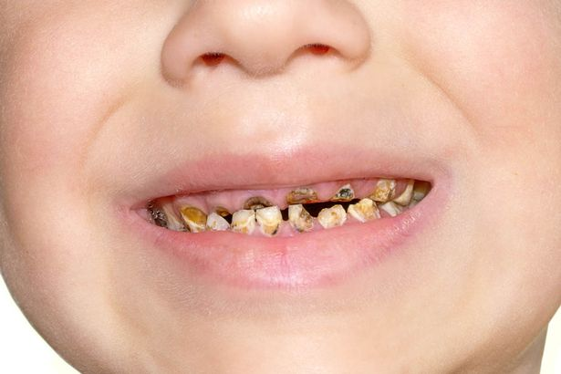

Slide 14

BRUSHING TEETH
      Clean teeth and gums can prevent a wide range of health issues
      bad breath
      cavities
      heart disease later in life
      Should:
      brush and floss at least twice per day
      if not after every meal

Slide 15
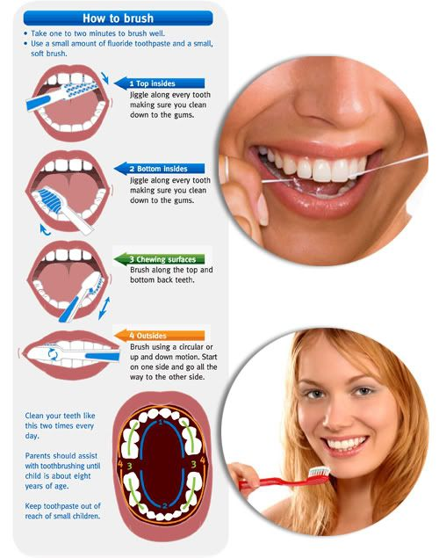
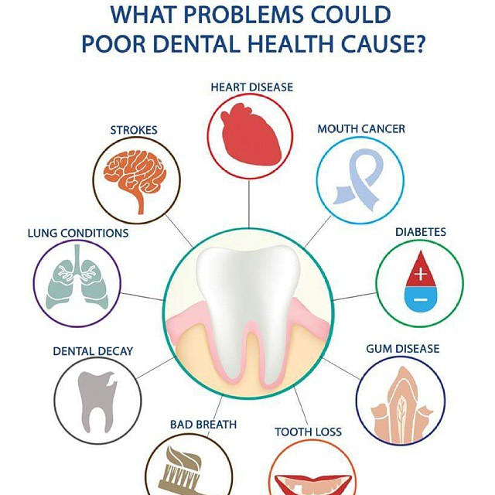

Slide 16

Your Brain Needs Sleep, so you can:
Remember what you learn
Pay attention and concentrate
Solve problems and think of new ideas
 | How Sleeps Work You spend the day running on the playground, learning at school, eating meals, and at night your body and brain get to rest, right? Wrong! In fact, while you are off in dreamland, your body and brain are very busy getting ready for a new day. That is why it is so important to give yourself time to sleep.
Your Body Needs Sleep, so your:
Muscles, bones, and skin can grow
Muscles, skin and other parts can fix injuries
Body can stay healthy and fight sickness

Slide 17
Kids ages 5 to 12 need 10 to 11 hours of sleep each night
When you get enough sleep you can: Pay attention better in school Be creative and think of new ideas Fight sickness so you stay healthy Be in a good mood Get along with friends and family Solve problems better | Without enough sleep you can: Forget what you learned Have trouble making good choices Be grumpy and in a bad mood Have trouble playing games and sports Be less patient with brothers, sisters, and friends Have trouble listening to parents and teachers

Slide 18
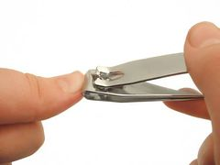

Cutting Nails
Fingernails are a breeding ground for bacteria. The germs that live under your child’s nails can easily transfer to their eyes, nose, and mouth. A weekly clipping will help get rid of dirt and reduce the possibility of painful ingrown nails.
Toileting
Wipe thoroughly from front to back and wash hands when done with soap and water. These healthy habits will help minimize irritation and keep infection.

